Slide 1
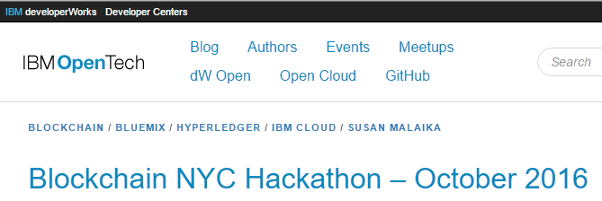
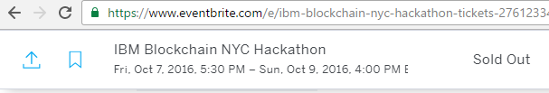
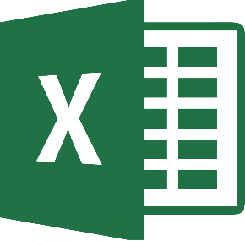

Spreadsheet Team
@spreadblock.slack.com
jsev (Jeremy), tmenner (Tom), @gregmisiorek (Greg), JohnnyY, mike (Anhmike), Rajesh, Nastia

Slide 2
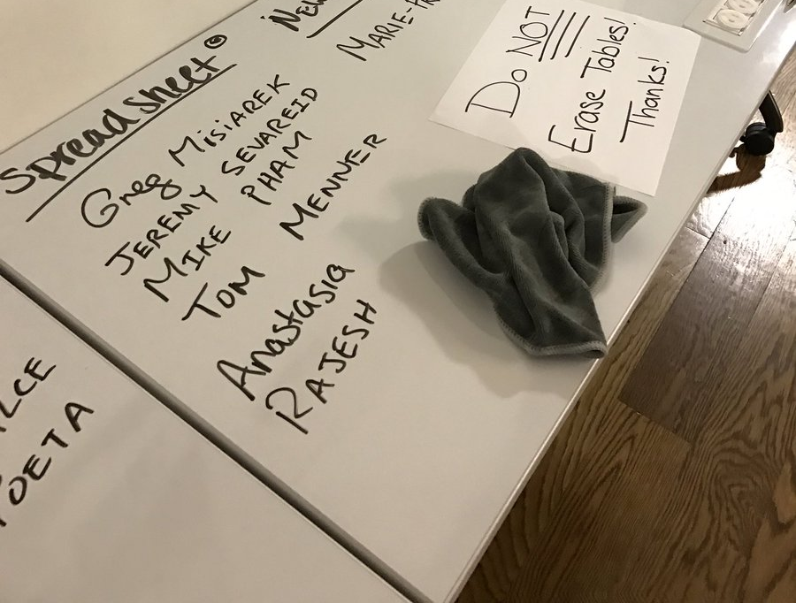
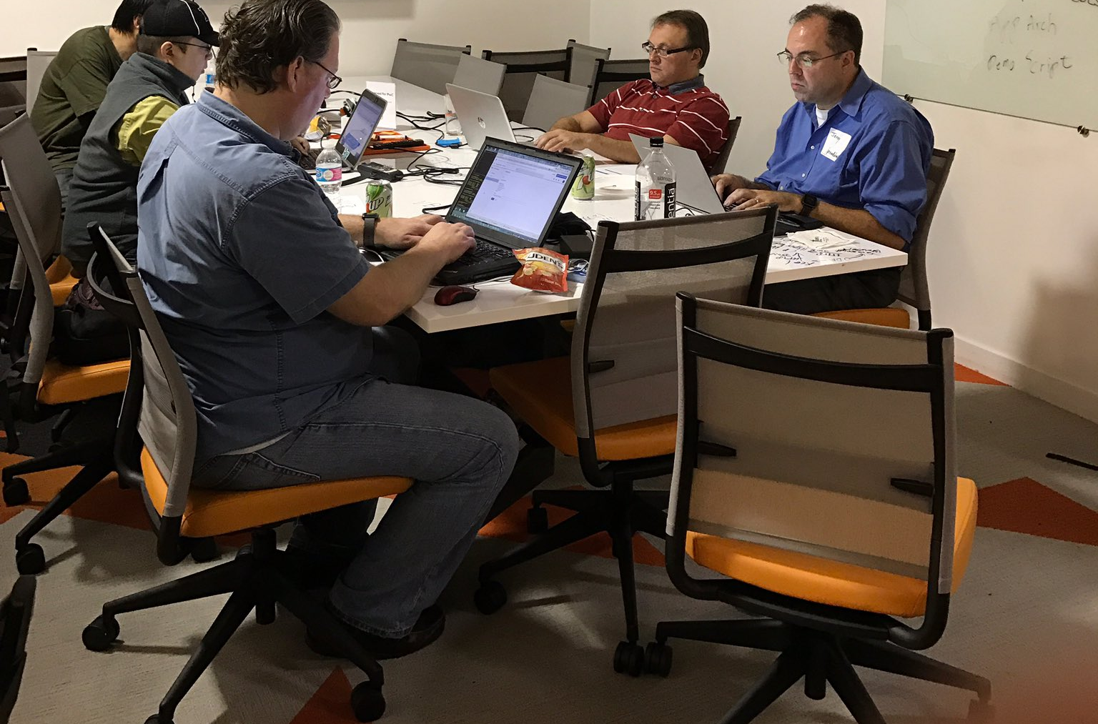
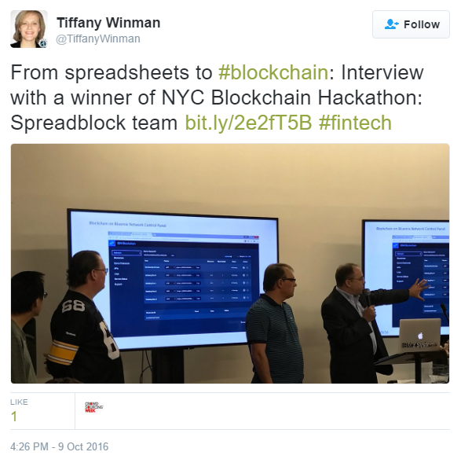
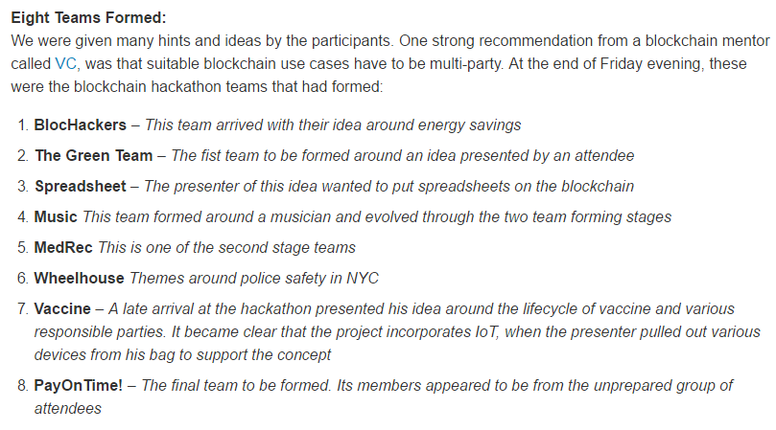
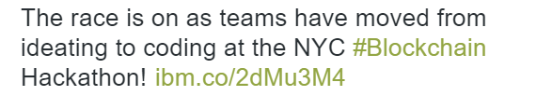
Three days in October at the IBM Blockchain NYC Hackathon at Galvanize in Soho
Friday Night
Saturday
Sunday
Day One Blog
https://wp.me/p6tTze-1TY
Day Two Blog
http://t.co/B30clNzRKK
Day Three Blog
https://developer.ibm.com/opentech/2016/10/10/ibm-blockchain-hackathon-nyc-the-winning-teams/
Facebook Live Interview
https://www.facebook.com/tiffany.winman/videos/10154467457531236/

Slide 3
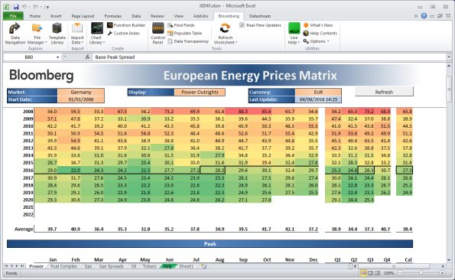
Why connect Excel to Blockchain?
Shared Use Cases
Business management
Corporate finance
Capital markets
Common Audience’s Core Tool For
Financial modeling
Data analysis and reporting
Ad hoc books and records
Adoption Jujitsu
When in Rome . . .
The original mix-in environment
Leverage vast ecosystem
“Home > Business Databases, company information > Advanced support for using the Bloomberg Excel add-in”,
https://bizlib247.wordpress.com/2016/08/04/advanced-support-for-using-the-bloomberg-excel-add-in/, Accessed 2016-10-26.

Slide 4
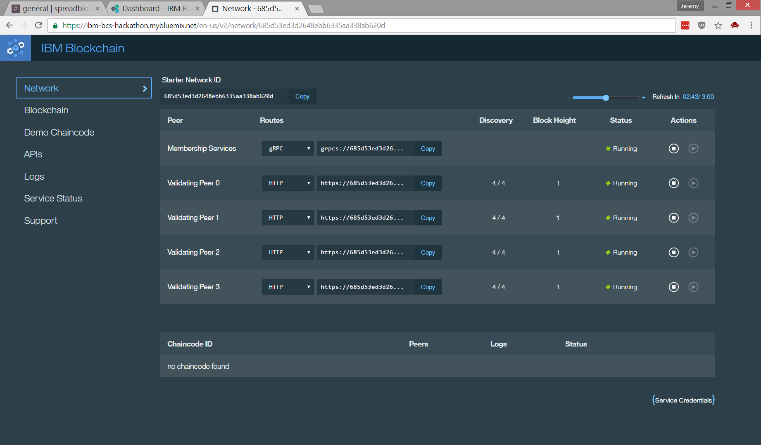
Excel2Hyperledger – The Proof-of-Concept (PoC)
HTTP
REST-ful
API
Hyperledger
On Bluemix

Slide 5


Excel2Hyperledger – The Possibilities
Hyperledger
On Bluemix
Smart Contracts Call REST-ful APIs
MS Graph
On Desktop, Spreadsheet as
GUI
Financial Model
Exception Manager
In Cloud, Ledger as
Shared transaction platform (e.g., commercial paper demo)
Shared data
Shared books & records
In Cloud, Spreadsheet as
Calc Engine
Financial Model
Data source

Slide 6
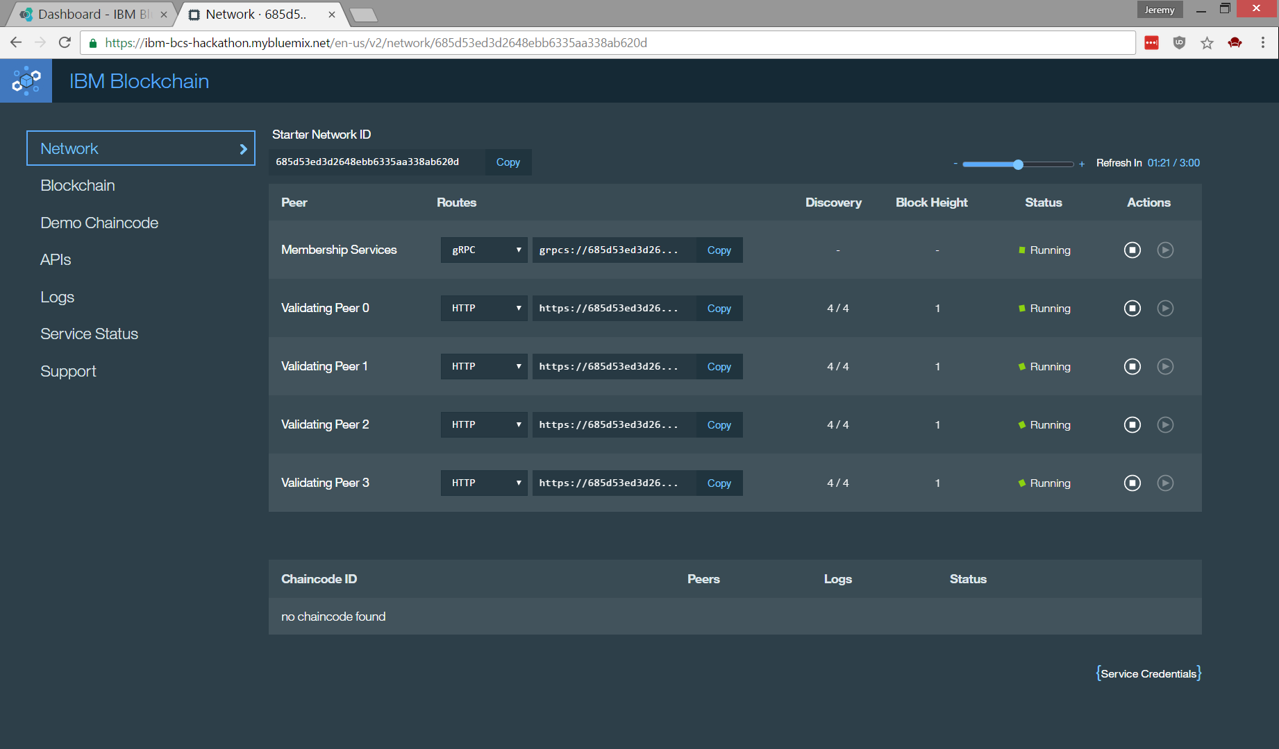
Blockchain on Bluemix Network Control Panel

Slide 7
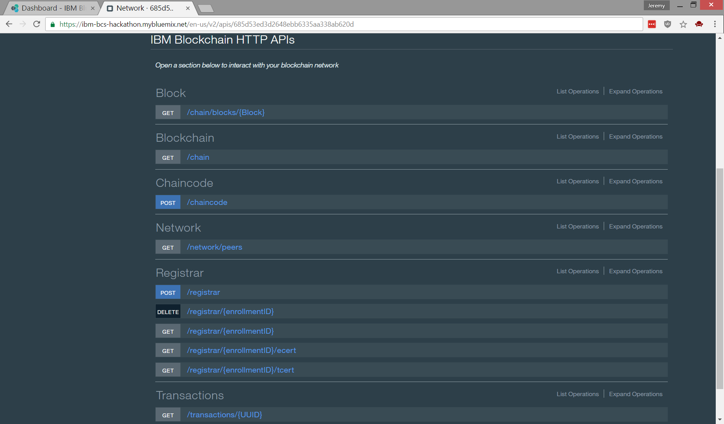
HTTP REST-ful Blockchain APIs

Slide 8
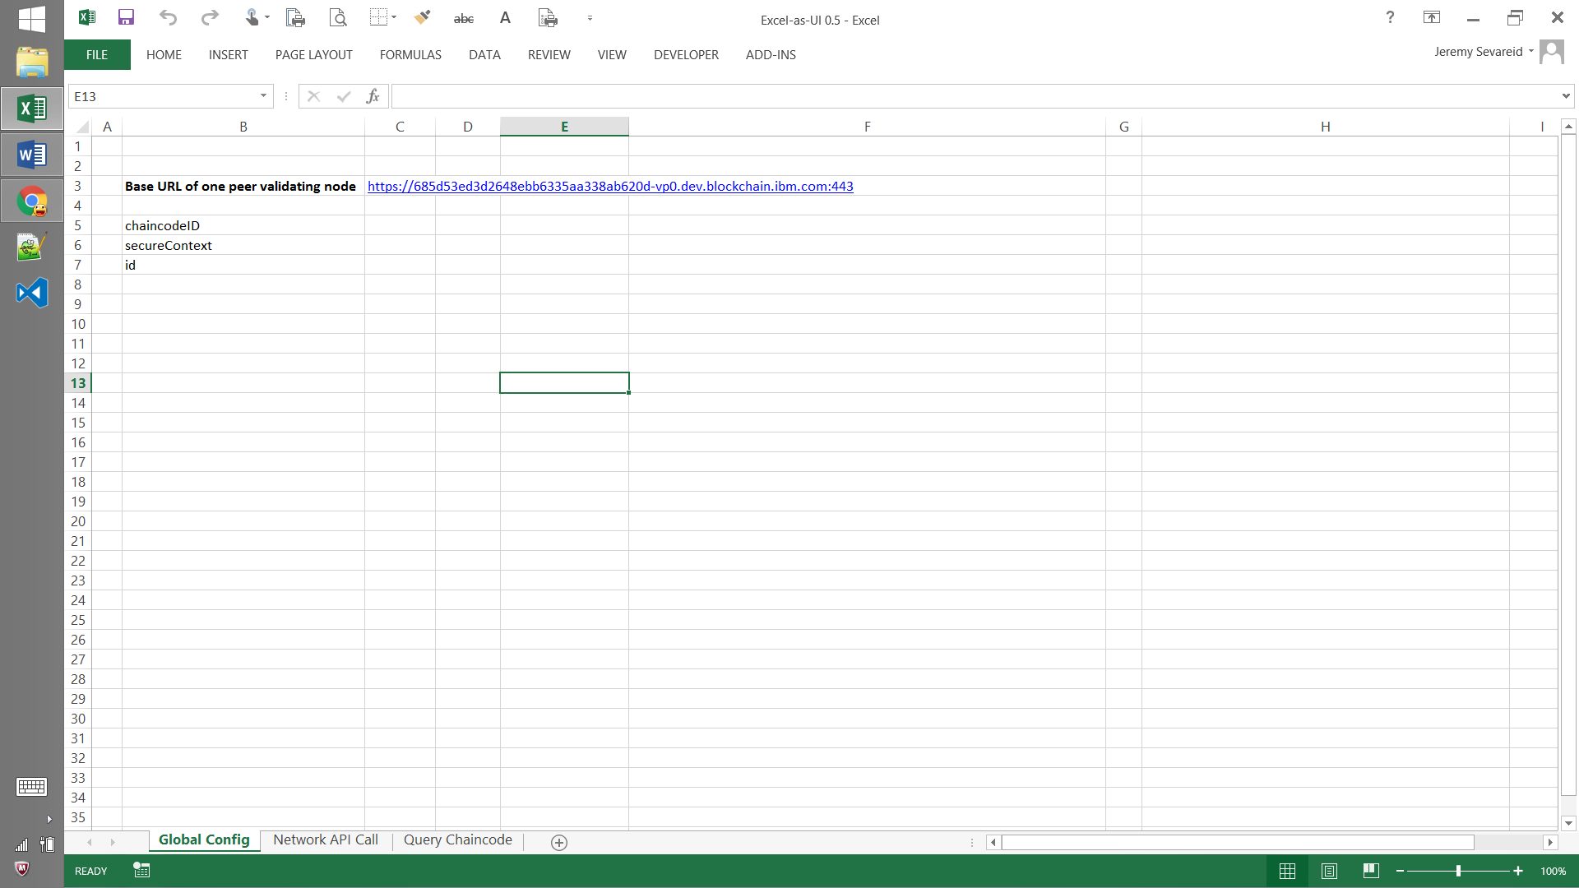
Excel as UI - Point to one of the 4 nodes running in Bluemix

Slide 9
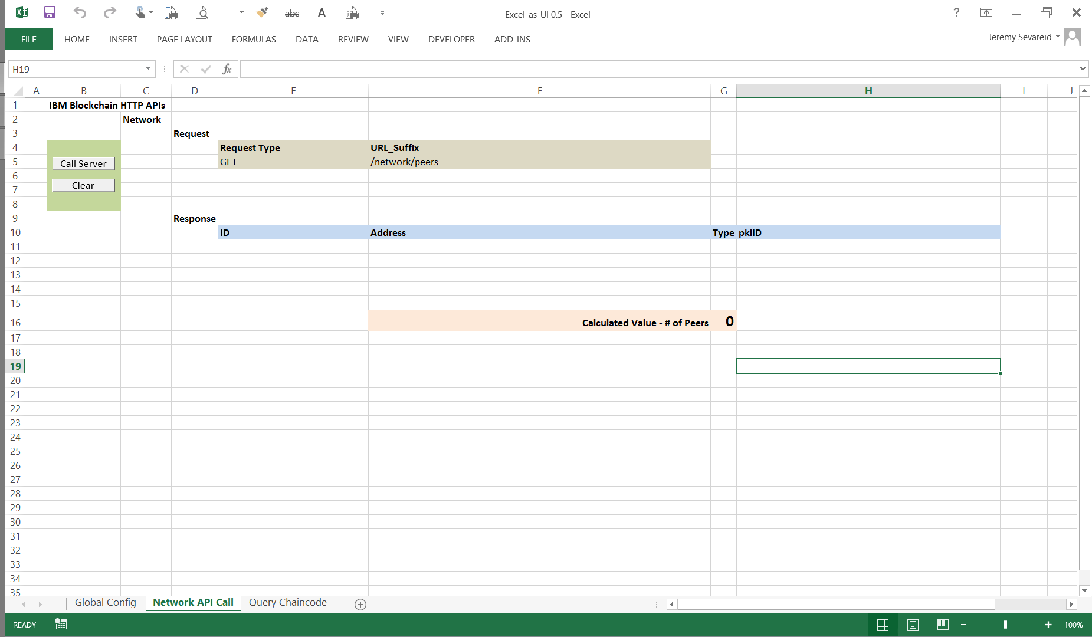
Excel as UI - Before

Slide 10
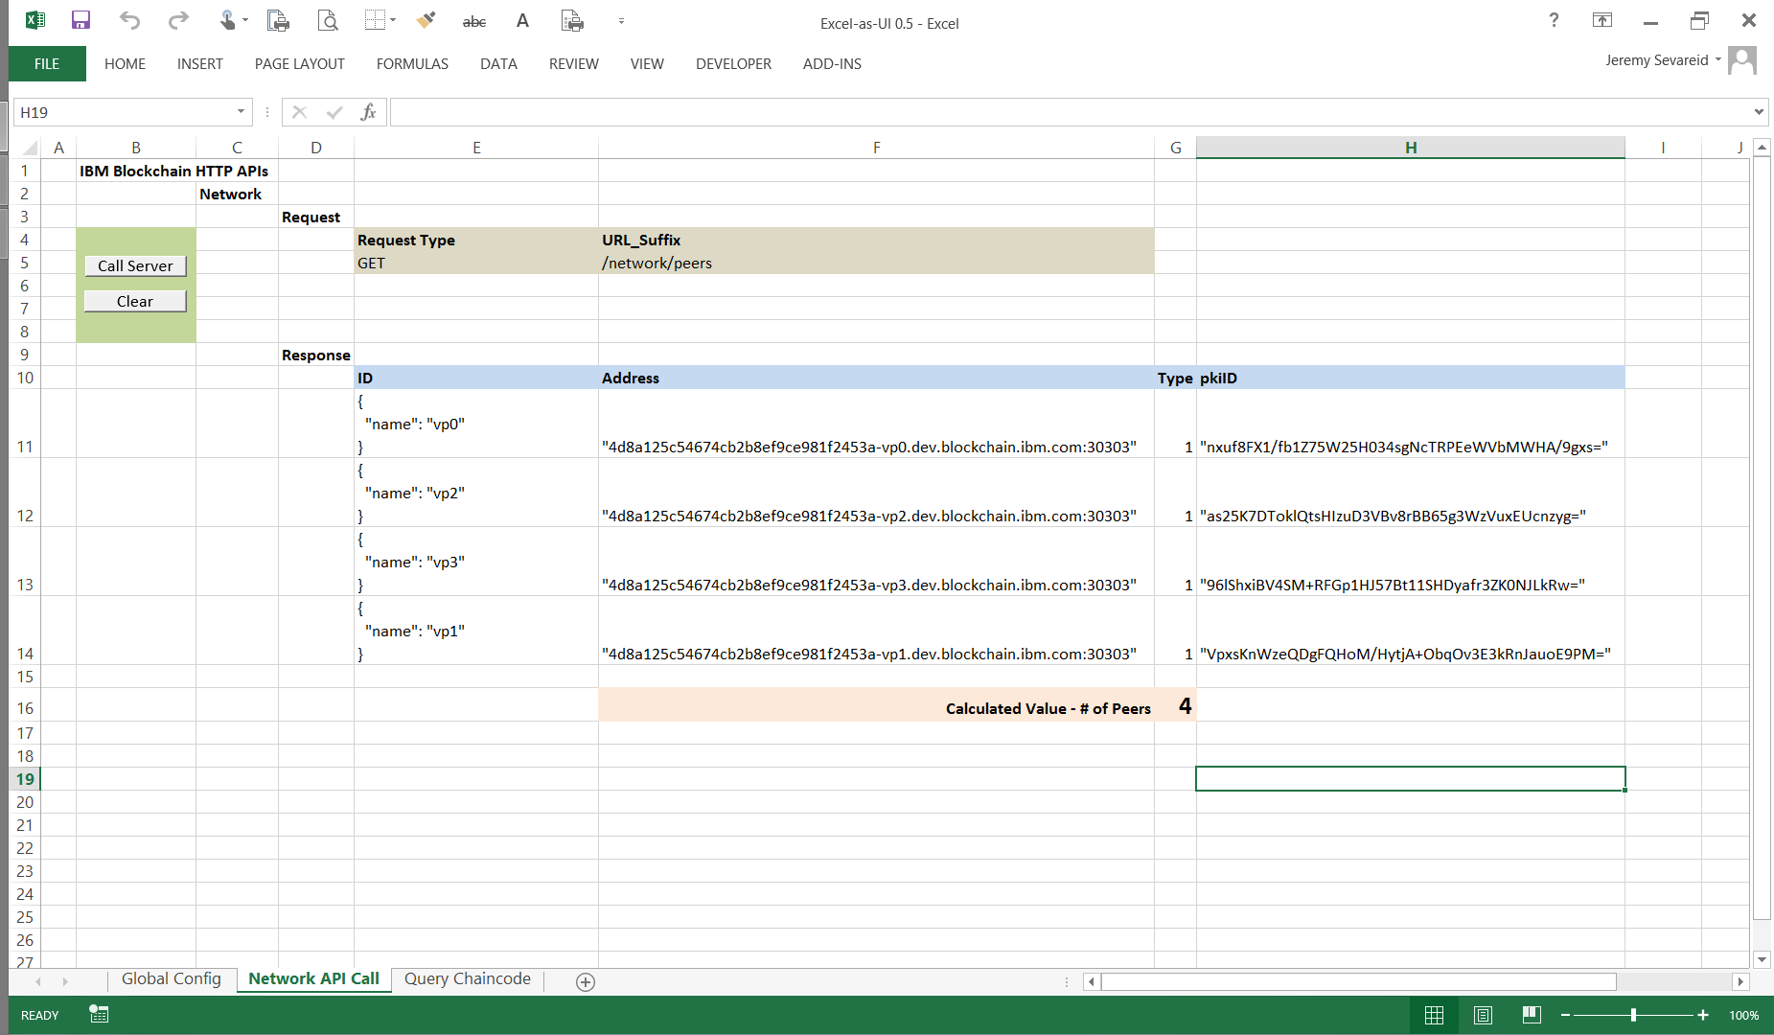
Excel as UI - After

Slide 11
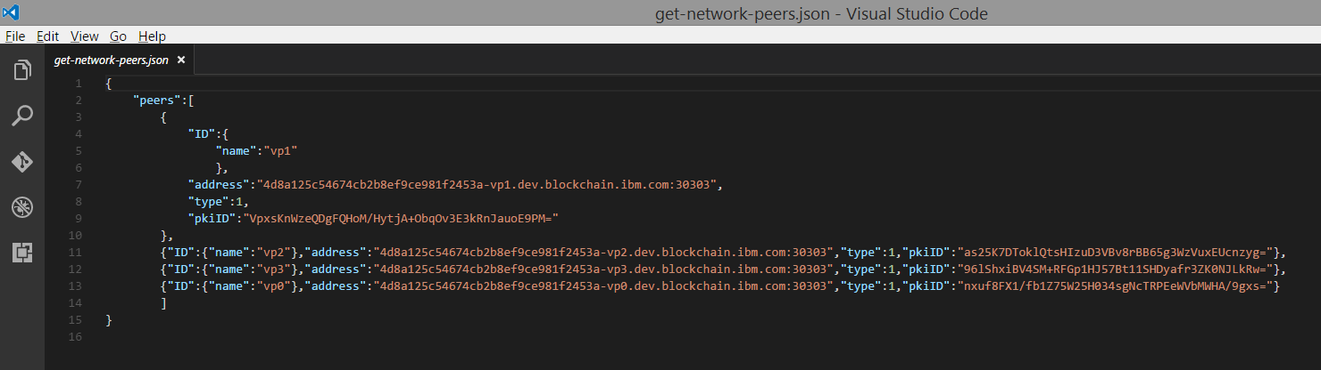
Blockchain peer node responds to HTTP REST-ful query with a JSON payload

Slide 12
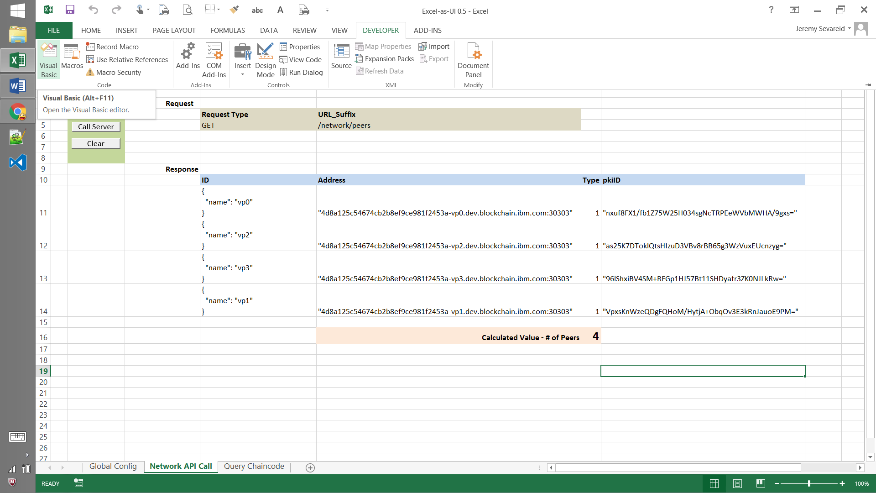
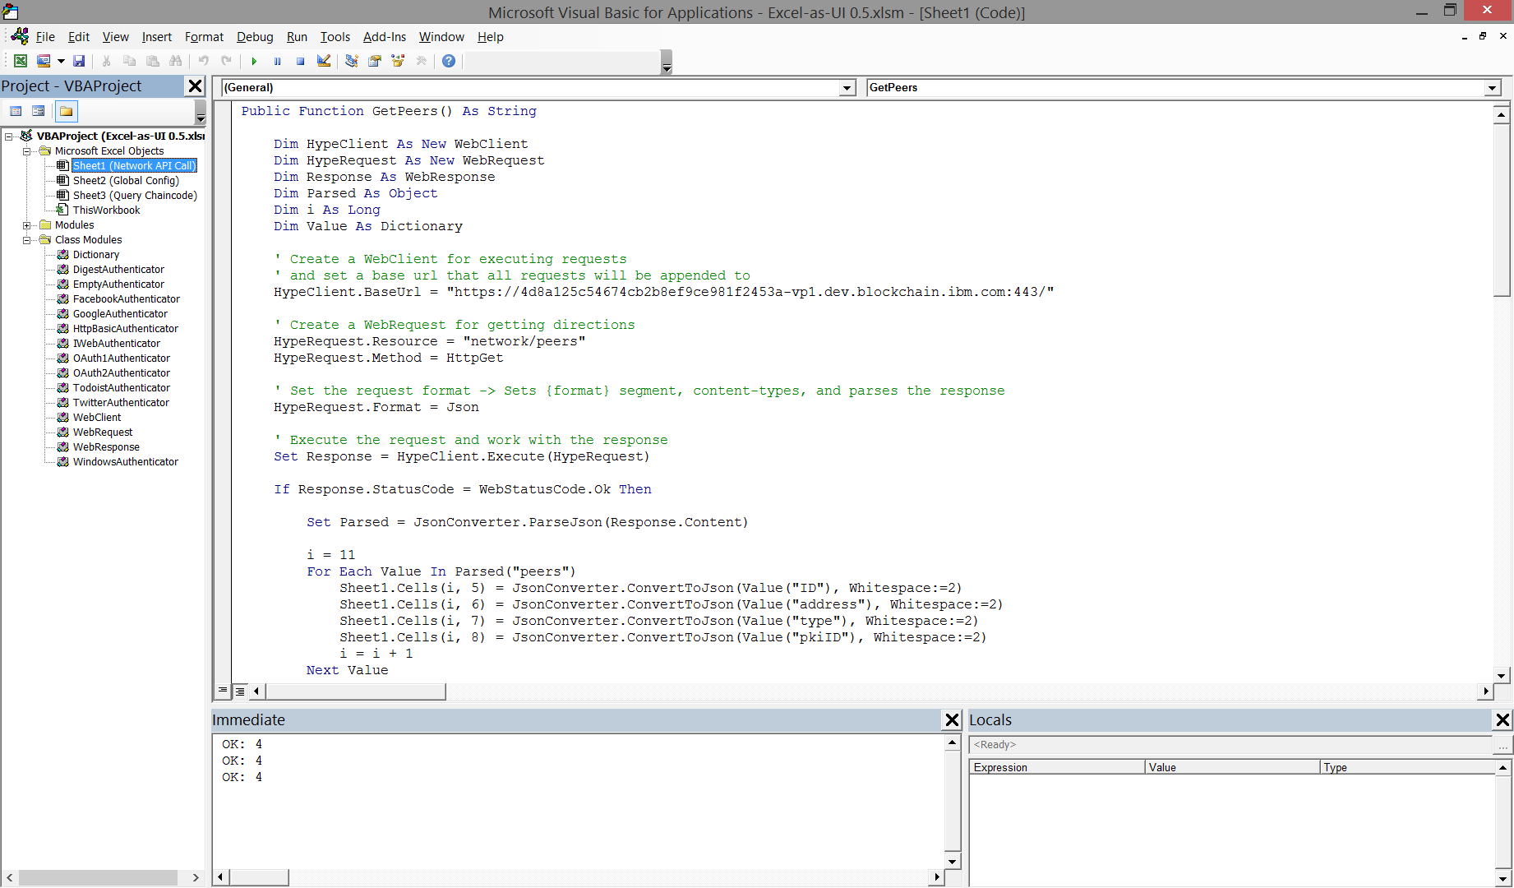
JSON-formatted message payload is parsed into sheet’s cells as structured data

Slide 13
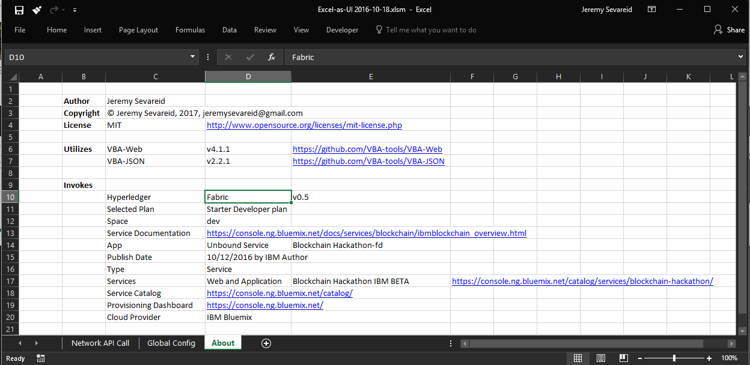
About

